Slide 1
Python-Class & Object
INT213

Slide 2
Introduction
Python has been an object-oriented language since it existed.
Because of this, creating and using classes and objects are downright easy.
This chapter helps you become an expert in using Python's object-oriented programming support.

Slide 3
How to create a Class in Python
There are following terms which you need to know while working with classes in Python
The “class” keyword
The class attributes and the instance attributes
The self in python class
The __init__ method (called constructor)
The __del__ method

Slide 4
1. The “class” Keyword
With the class keyword, we can create a Python class as shown in the example below.
class BookStore:
pass

Slide 5
Constructor in a python class
def __init__ ( )
def __init__ is a class method but called initializer
It is special method/function of class
It automatically initialize the instance variables of class
It is automatically executed when we create object/instance of class

Slide 6
Class attributes belong to the class itself they will be shared by all the instances. Such attributes are defined in the class body parts usually at the top.
instance attributes are not shared by objects. Every object has its own copy of the instance attribute

Slide 7
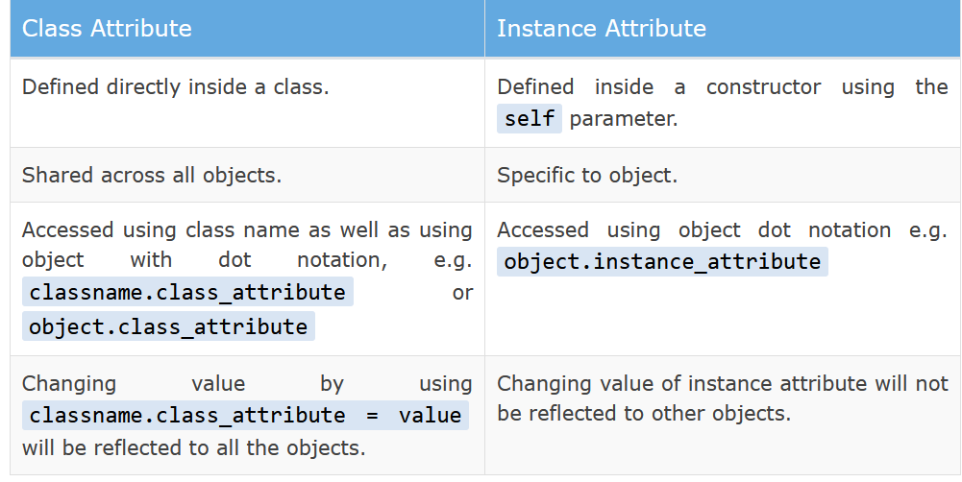

Slide 8
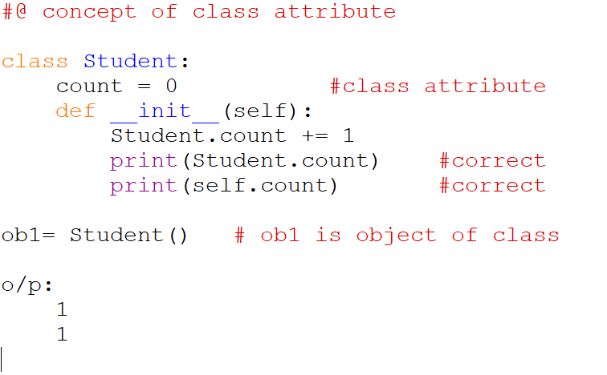

Slide 9
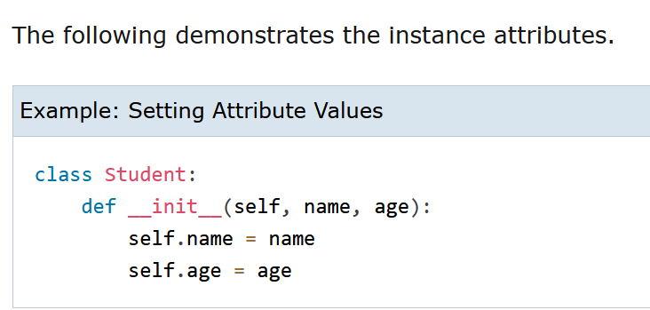

Slide 10
2. The Instance Attributes/parameters
These are object-specific attributes defined as parameters to the __init__ method. Each object can have different values for themselves.
In the below example, the “attrib1” and “attrib2” are the instance attributes.
Receives the instance of class automatically
class BookStore:
def __init__(self, attrib1, attrib2): self.attrib1 = attrib1
self.attrib2 = attrib2

Slide 11
Self in python class
The self parameter is used to access variables of the the class.
It is a reference to the current instance of the class.
It must be first parameter of any function in the class.

Slide 12
As no keywords in python like
Public, private, protected
But
All attributes and methods are public by default
To make these private, use double underscores__

Slide 13
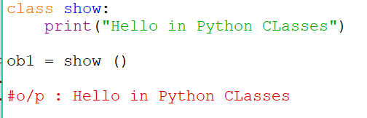
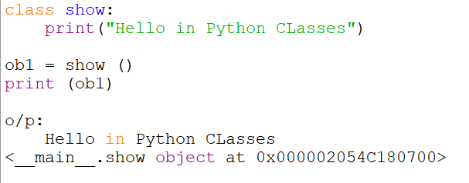

Slide 14
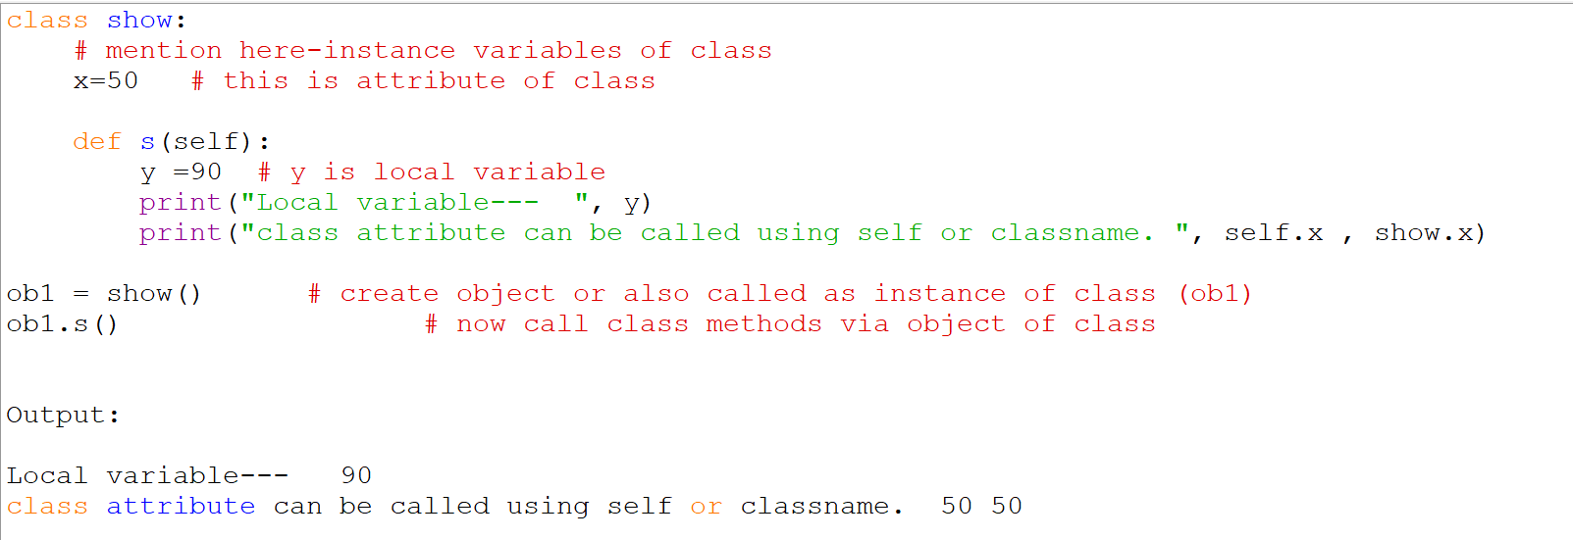

Slide 15
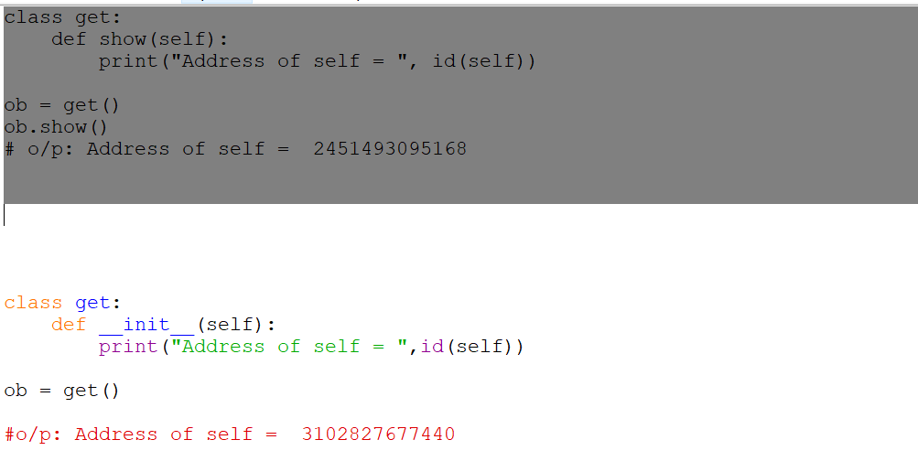
Self is always pointing to Current Object.

Slide 16
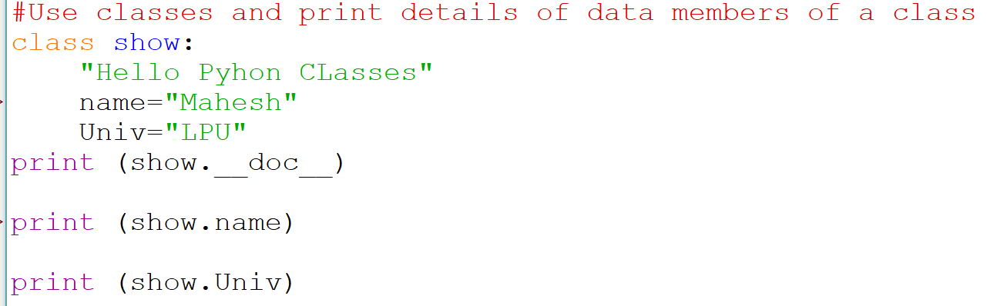
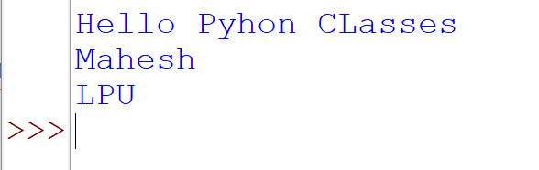

Slide 17
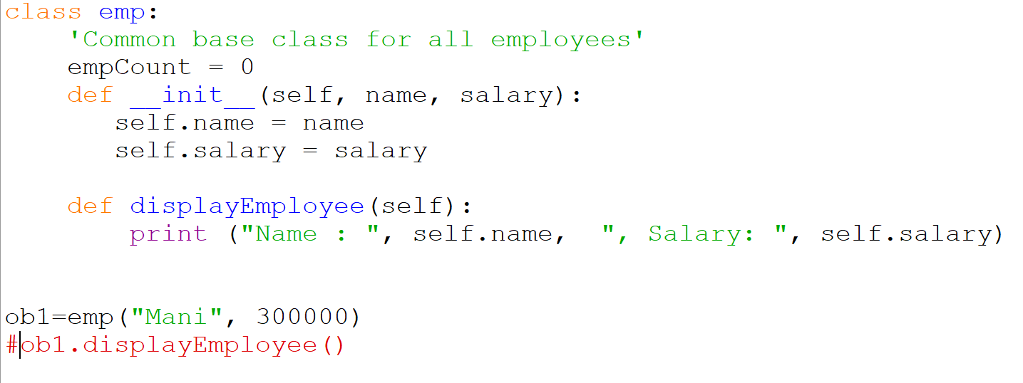
Name : Mani , Salary: 300000

Slide 18
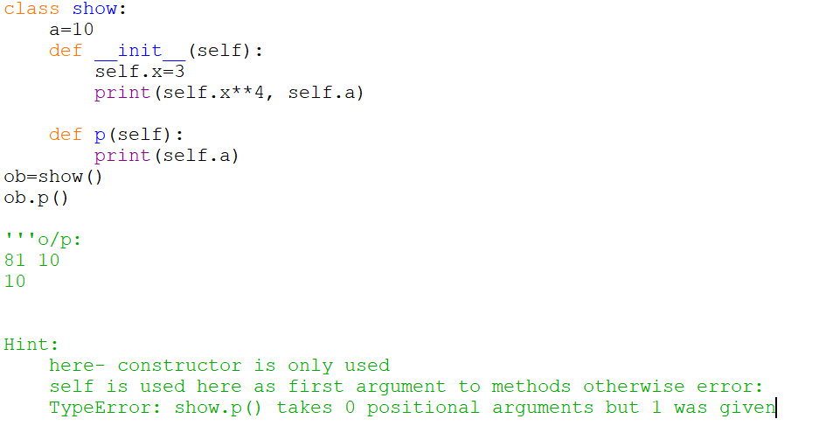

Slide 19
Overview of OOP Terminology
Class: A user-defined prototype for an object that defines a set of attributes that characterize any object of the class. The attributes are data members (class variables and instance variables) and methods, accessed via dot notation.
Class variable: A variable that is shared by all instances of a class. Class variables are defined within a class but outside any of the class's methods. Class variables are not used as frequently as instance variables are.
Instance variable: A variable that is defined inside a method and belongs only to the current instance of a class.
Data member: A class variable or instance variable that holds data associated with a class and its objects.
Instance: An individual object of a certain class. An object obj that belongs to a class Circle, for example, is an instance of the class Circle.
Instantiation: The creation of an instance of a class.
Method : A special kind of function that is defined in a class definition.
Object: A unique instance of a data structure that's defined by its class. An object comprises both data members (class variables and instance variables) and methods.

Slide 20
Overview of OOP Terminology
Inheritance: The transfer of the characteristics of a class to other classes that are derived from it.
Function overloading: The assignment of more than one behavior to a particular function. The operation performed varies by the types of objects or arguments involved.
Operator overloading: The assignment of more than one function to a particular operator.

Slide 21
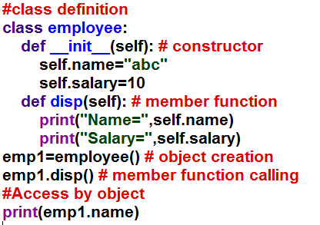
Example

Slide 22
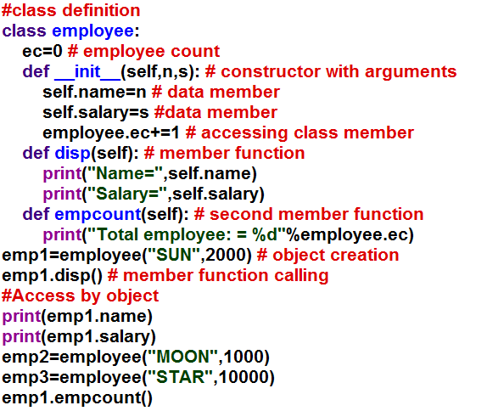
Example 1
The class statement creates a new class definition. The name of the class immediately follows the keyword class followed by a colon as follows −

Slide 23
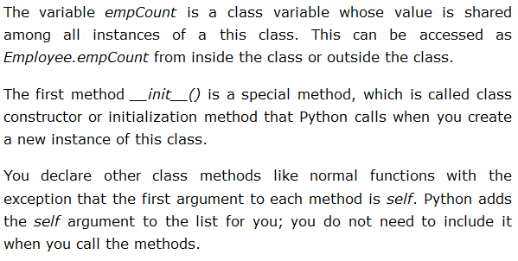

Slide 24
Creating Instance Objects
"This would create first object of Employee class"
emp1 = Employee("Zara", 2000)
"This would create second object of Employee class“
emp2 = Employee("Manni", 5000)

Slide 25
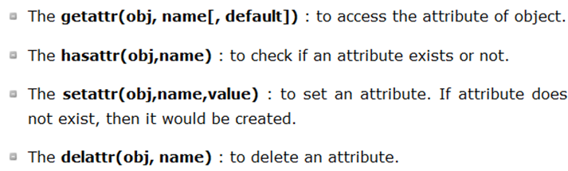
Accessing Attributes
emp1.displayEmployee()
emp2.displayEmployee()
print ("Total Employee %d" % Employee.empCount)

Slide 26
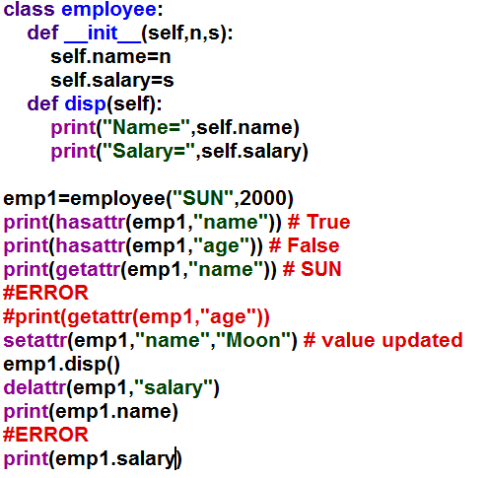

Example 3

Slide 27
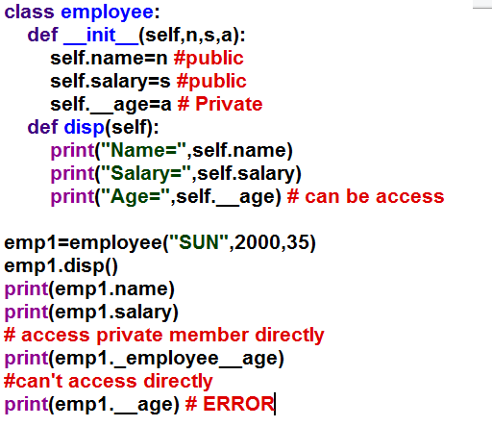
Public and private member of class

Slide 28
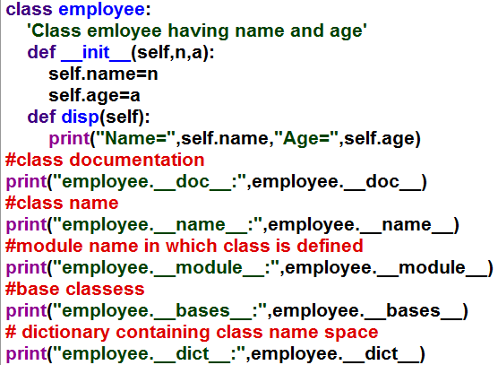
Example 5

Slide 29
Destroying Objects (Garbage Collection)
Python deletes unneeded objects (built-in types or class instances) automatically to free the memory space.
The process by which Python periodically reclaims blocks of memory that no longer are in use is termed Garbage Collection.

Slide 30
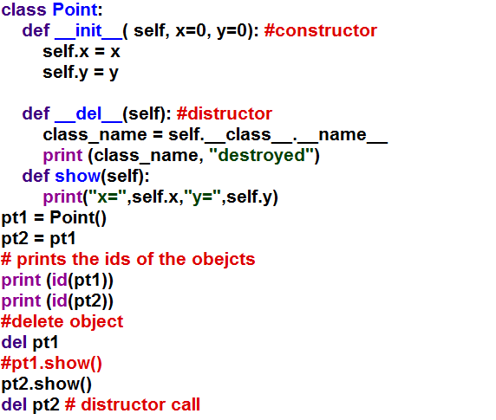
Example 6

Slide 31
Questions
1. Write a class name point for creating 2D points through constructor.
2.Read and print details of a student using class programming having attributes name, roll no, reg no, percentage.
3. Write a class name time, having attributes hours, minutes, seconds. Define a member function to add two times.
4. Write a class name threeD, having attributes x, y and z. Define a member function dist to calculate Euclidian distance of two threeD points.
5. Write a program that has a class student that stores roll number, name and marks (in three subjects) of the students. Display the information (roll number, name and total marks) stored about the student.

Slide 32
Time 1 : 2 Hour, 30 Minute and 25 Second
Time 2 : 5 Hour, 35 Minute and 40 Second
Total Time : 8 Hour and 6 Minute and 5 Second

Slide 33
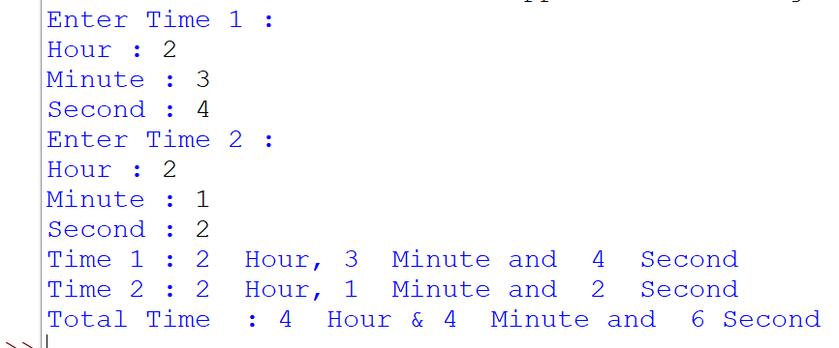
#take 2 times, and add these
print("Enter Time 1 :")
h1=int(input("Hour : "))
m1=int(input("Minute : "))
s1=int(input("Second : "))
print("Enter Time 2 :")
h2=int(input("Hour : "))
m2=int(input("Minute : "))
s2=int(input("Second : "))
s3=(s1+s2) %60 # if 65 then s3= 5 seconds
m3=(m1+m2+ ((s1+s2)//60 )) %60 # floor of s1+s2 means converted into mins.
h3=h1+h2+(m1+m2+(s1+s2)//60)//60
print("Time 1 :",h1," Hour, ",m1," Minute and ",s1," Second")
print("Time 2 :",h2," Hour, ",m2," Minute and ",s2," Second")
print("Total Time :",h3," Hour and ",m3," Minute and ",s3,"Second")

Slide 34
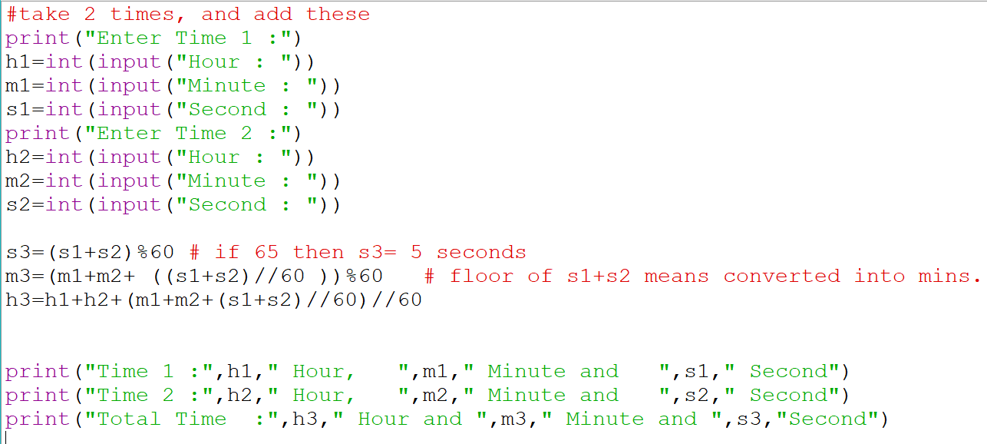

Slide 35
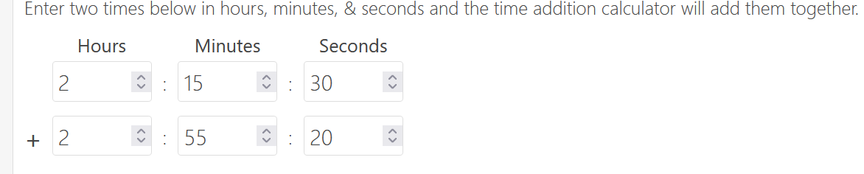
It is 5 hrs, 10 mins, 50 secs
Step One: start by adding the hours, minutes, and seconds of each time together separately.
If the minutes and seconds are both less than 60, then that’s it, you’re done!
Step Two: if the seconds are larger than 60, simply add 1 to the minutes and subtract 60 from the seconds.
Step Three: if the minutes are larger than 60, then add 1 to the hours and subtract 60 from the minutes.

Slide 36
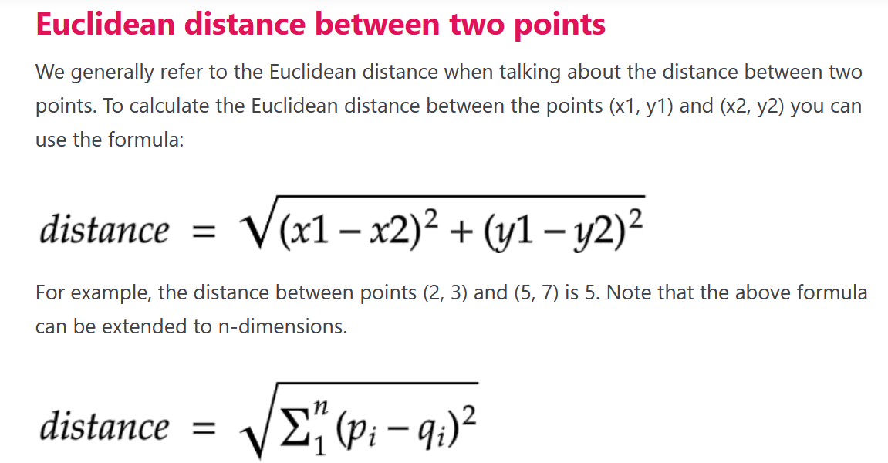
Write a class name threeD, having attributes x, y and z. Define a member function dist to calculate Euclidian distance of two threeD points.

Slide 37
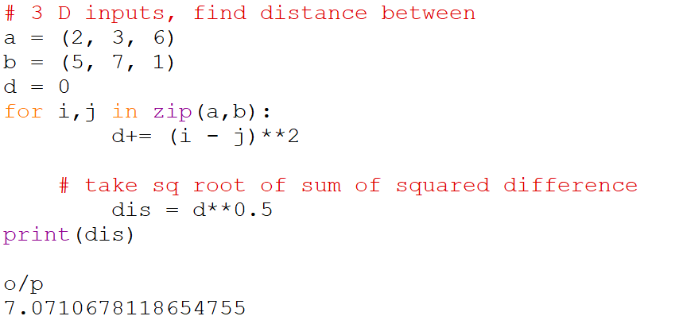
Return euclidean distance between points p and q assuming both to have the same number of dimensions

Slide 38
#Distance b/w 2 points
# point a
x1 = 2
y1 = 3
# point b
x2 = 5
y2 = 7
# distance b/w a and b
#distance = ((x1 - x2)**2 + (y1 - y2)**2)**0.5
d= ((2-5)**2 + (3 - 7)**2)**0.5

Slide 39
d= pow((pow((2-5),2) + pow((3-7),2) ),0.5)
print("Distance b/w=({},{})and({},{})is({})".format(x1,y1,x2,y2,d))
o/p
Distance b/w=(2,3)and(5,7)is(5.0)

Slide 40
# 3 D inputs, find distance between them
a = (2, 3, 6)
b = (5, 7, 1)
d = 0
for i,j in zip(a,b):
d+= (i - j)**2
# take sq root of sum of squared difference
dis = d**0.5
print(dis)
o/p
7.0710678118654755

Slide 41


